Slide 3
LEFT KNEE DOWN - POST

Slide 4
LEFT KNEE DOWN – MODIFIED KICKSTAND

Slide 5
LEFT KNEE DOWN –KICKSTAND

Slide 6
RIGHT KNEE DOWN – POST

Slide 7
LEFT KNEE DOWN – MODIFIED KICKSTAND

Slide 8
LEFT KNEE DOWN –KICKSTAND

Slide 9
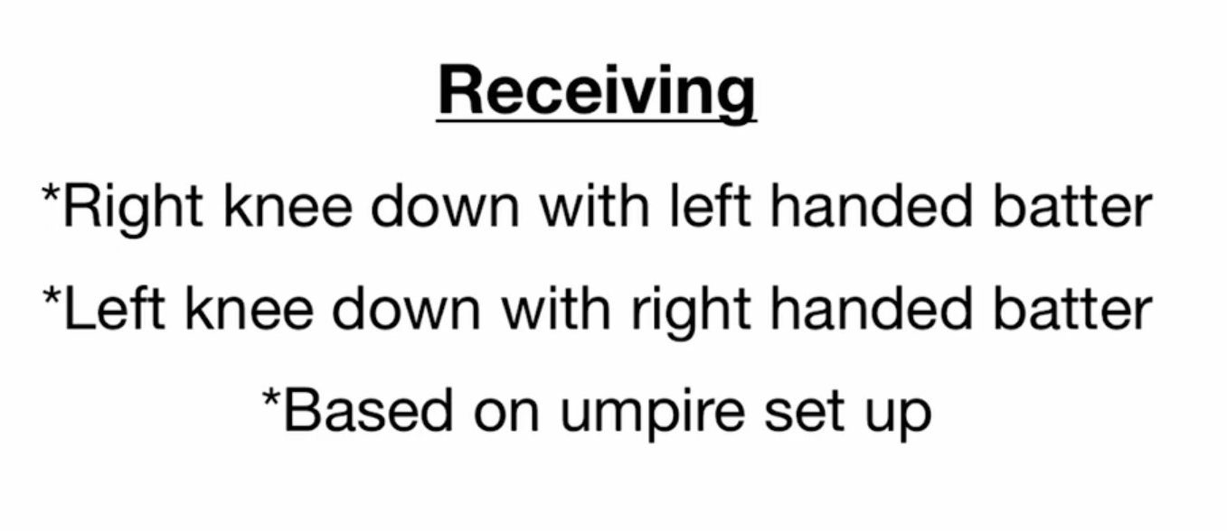

Slide 10
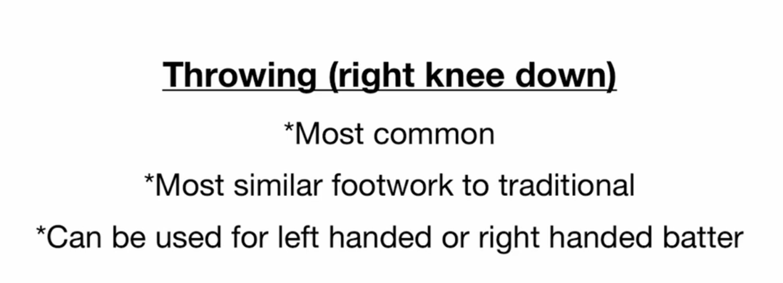

Slide 11
