Slide 1
BECKETT
C | BECKETT, BRANDEL, DYLAN, BRICE, BRADY E, BRENDAN, BRAYDEN
1B | BECKETT, BRANDEL, DYLAN, TYSON, BLAKE
2B | BRANDEL, BRICE, SAM, BRADY E,
3B | BRANDEL, DYLAN, BRICE, BRADY E, BRENDAN
SS | BRANDEL, BRICE, SAM, BRADY E, BRADY B, BRENDAN
OF | EVERYONE
HERE ARE THE GENERAL POSITIONS I THINK THE GUYS CAN/WILL PLAY.
THIS DOES NOT INCLUDE PITCHING.
BRADNEL
DYLAN
BRICE
TYSON
NAME | PRIMARY POSITIONS
BECKETT | 1B, C, 2B, OF
BRANDEL | SS, C, OF
DYLAN | C, 3B, 1B, OF
BRICE | 3B, C, SS, OF
TYSON | 1B, OF
SAM | OF, 2B, SS
BRADY E | 3B, SS, C, OF
BRADY B | SS, 3B, OF
BLAKE | OF, 1B, 2B
CARTER | 2B, OF
BRENDEN | 2B, SS, C, 3B, OF
BRAYDEN | OF, 2B, C
SAM
BRADY E
BRADY B
BLAKE
CARTER
BRENDAN
BRAYDEN

Slide 2
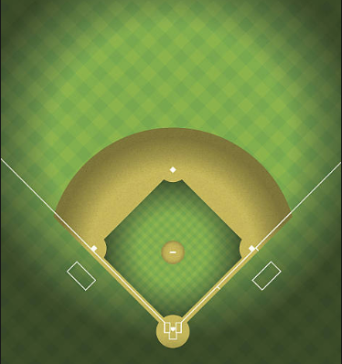
1 | BRADY B
2 | BECKETT
3 | BRICE
4 | BRADY E
5 | DYLAN
6 | TYSON
7 | CARTER
8 | SAM
9 | BLAKE
10 | BRAYDEN
11 | BRENDAN
12 | BRANDEL
BRADY E
BRAYDEN
BRENDAN
SAM
BLAKE
BRADY B
BRADNEL
CARTER
BRICE
BECKETT
TYSON
DYLAN

Slide 3
1 | BRADY B
2 | BRANDEL
3 | BECKETT
4 | BRICE
5 | BRADY E
6 | DYLAN
7 | TYSON
8 | CARTER
9 | BLAKE
10 | SAM
11 | BRAYDEN
12 | BRENDEN
BRICE
BRAYDEN
SAM
TYSON
BLAKE
BRADNEL
BRENDAN
CARTER
DYLAN
BECKETT
BRADY B
BRADY E

Slide 4
1 | BECKETT
2 | BRANDEL
3 | BRICE
4 | BRADY E
5 | DYLAN
6 | TYSON
7 | CARTER
8 | SAM
9 | BLAKE
10 | BRAYDEN
11 | BRENDAN
12
BRENDAN
SAM
BRAYDEN
BLAKE
BRADNEL
CARTER
BECKETT
BRICE
TYSON
BRADY B
DYLAN
*Lineup without Brady Baldwin
BRADY E

Slide 5
1
2
3
4
5
6
7
8
9
10
11
12
BRENDAN
BRAYDEN
TYSON
SAM
BRADY B
BRADNEL
BLAKE
CARTER
BRADY E
BRICE
BECKETT
DYLAN

Slide 6
BECKETT
BRADNEL
DYLAN
BRICE
TYSON
SAM
BRADY E
BRADY B
BLAKE
CARTER
BRENDAN
BRAYDEN

Slide 7
BECKETT
BRADNEL
DYLAN
BRICE
TYSON
SAM
BRADY E
BRADY B
BLAKE
CARTER
BRENDAN
BRAYDEN

Slide 8
BECKETT
BRADNEL
DYLAN
BRICE
TYSON
SAM
BRADY E
BRADY B
BLAKE
CARTER
BRENDAN
BRAYDEN

Slide 9
BECKETT
BRADNEL
DYLAN
BRICE
TYSON
SAM
BRADY E
BRADY B
BLAKE
CARTER
BRENDAN
BRAYDEN

